Slide 1

West Nile Virus Prediction
By: Melvin, Benedict, SUfyan

Slide 2
Contents
EDA
Feature Selection
Classification Modelling

Slide 3
EDA
What kind of cleaning is needed? Document any potential issues that will need to be resolved
Weather stations needed to find Euclidian distance for nearest traps around vicinity
Weather lag needed as some of the coefficients might not make sense
Show hotspots across years different
At first we looked at month, generally we have a feel that August was the hotspot? But it is not true and consistent across years
Show trends across the years

Slide 4
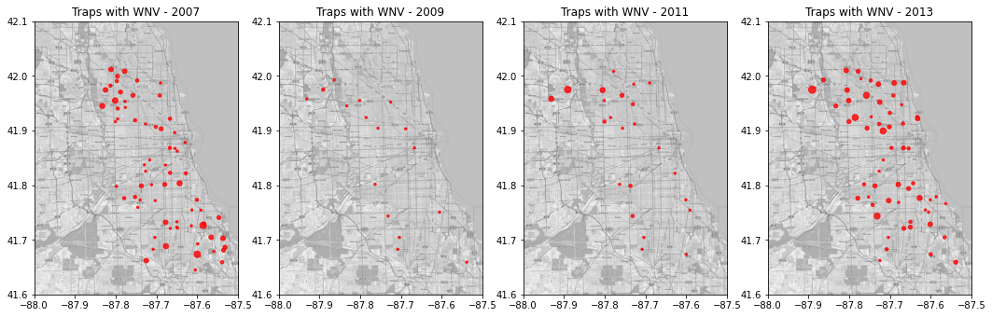
EDA: Hotspots across years
Describe abit on trend being non consistent

Slide 5
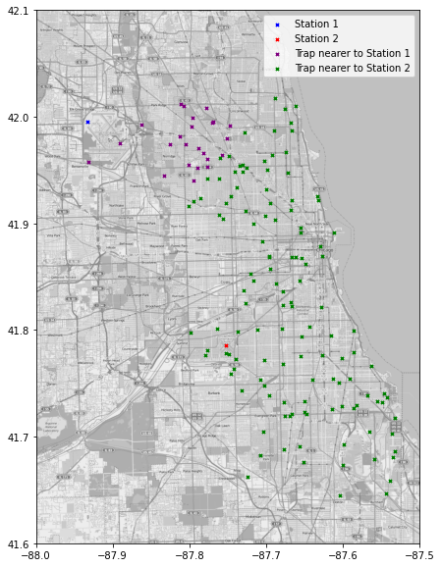
EDA: Weather stations nearby
Describe distance used.
How many traps per weather stations
Weather station 2 – no value, imputed based on Weather 1

Slide 6
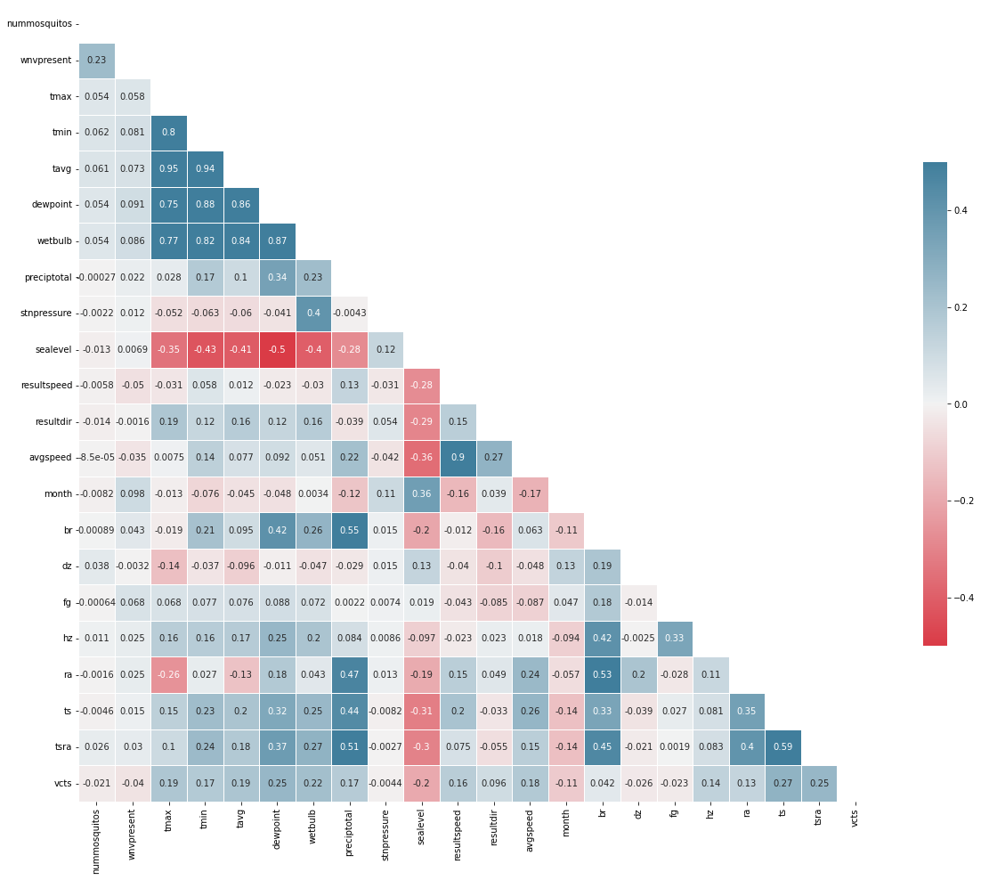
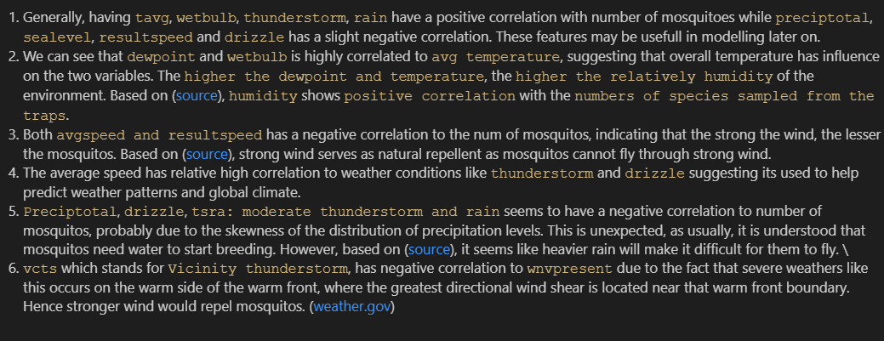
EDA: Heatmap
Will summarise after confirm
Without weather lag

Slide 7
EDA: Heatmap (With weather lag)
Will summarise after confirm
With Weather lag

Slide 8
Feature selection
Weather lag

Slide 9
Classification model
Classifier | Balancing Technique | Train ACC | TEST ACC | Sensitivity | Specificity | ROC_AUC
Logistic Regression | SMOTE
RandomForest | SMOTE
RandomForest | Class_weight: ‘Balanced Subsample’
SVC | Class_weight: Optimised
XGBoost | Scale_pos_weight:21

Slide 10
Cost Analysis

